Slide 1

Emerging Sources Of Finance

Slide 2

Sr. No. | Topics
1 | Introduction
2 | Sources of Finance
3 | Private Equity
4 | Venture Capital
5 | Difference between PE & VC
6 | Real Estate Investment Trust
7 | Infrastructure Investment Trusts
8 | Conclusion

Slide 3

Introduction & Need
Finance is the study and management of money, investments, and other financial instruments. It involves how individuals, businesses, and organizations raise, allocate, and use funds over time, taking into account the risks and returns associated with those funds.
Businesses need finances for daily operations and to meet essential expenses and payments.
Funds for business growth, market competition, and to keep your business
operational and maintain your customer base..
Inefficient management of finances could lead to liquidity shortages.

Slide 4
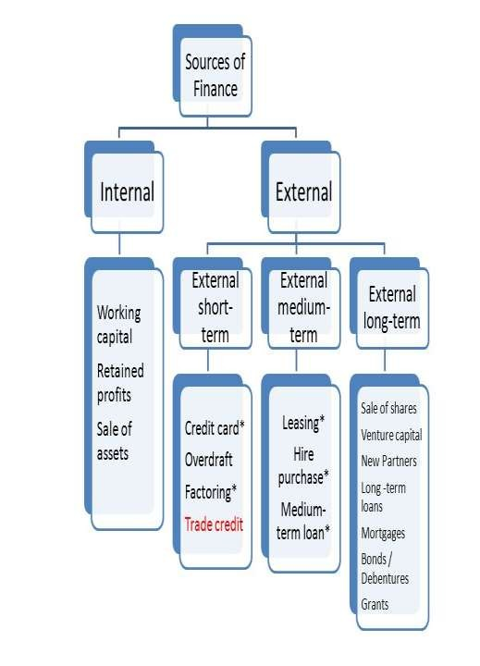
Sources of Finance
Main sources of funding for a business :
Revenues from business
operations
Investor finances such as owners’, partners or venture capital
Loans from individuals or
Financial institutions.
Short-term sources of finance, such as cash revenue and advance receipts, must be obtained sufficiently through effective debt and discount policies.
Long-term sources of finance must be available for the achievement of long-term goals, such as purchasing new machines.

Slide 5

Private Equity (PE) refers to investment funds that invest directly in private companies or buy out public companies to take them private. These investments are not traded on public stock exchanges and are usually made by private equity firms or wealthy individuals.
The main goal of private equity is to invest in a company, improve its operations, increase its value, and eventually sell it for a profit. Private equity investments are typically long-term and involve active management, strategic guidance, and financial restructuring to enhance the company’s performance.
Private Equity

Slide 6




What drives private equity?
Raising Capital
Increasing Regulation of Public Markets
Effect on Public Markets
Financing the Private Equity Boom

Slide 7

Exit Routes in Private Equity
The company goes public through an Initial Public Offering (IPO), allowing PE investors to sell their shares to public investors.
The company is sold to another company or strategic buyer in a trade sale, often for synergies or expansion.
The PE firm sells its stake to another private equity firm or financial investor in a secondary sale.
The original owners or management team buy back the equity stake from PE investors in a management buyout (MBO).
In rare cases, the company may be liquidated, and its assets are sold to return capital to investors

Slide 8


Advantages
Disadvantages
Provides long-term capital to companies for growth and expansion.
Offers strategic guidance and expertise from experienced private equity investors.
Can improve company performance through better management, restructuring, and operational efficiency.
Flexible financing compared to traditional loans, without regular interest payments.
Potential for high returns for both investors and the company’s stakeholders
High risk due to illiquidity and dependence on company performance.
Investors often require significant control or influence, which may limit management freedom.
Long-term investment horizon may not suit all investors.
Potential for conflicts of interest between investors and management.
PE funding can be expensive due to high expected returns and fees charged by PE firms

Slide 9


Application of Private Equity (With Real-Life Example)
In 2006, TPG made a private equity investment of $100 million into “Shriram City Union Finance”.
In 2008, TPG earned 4 times its original investment by selling a 20% stake to the Apax Group.
Texas Pacific Group
APAX entered the Indian market in 2007 and made an investment of $104 million in the health care industry.
APAX earned $4 billion upon the sale of IT firm IGATE
And enabled a return of $1.3 billion on the 2011 investment.

Slide 10

Venture Capital
Venture Capital is a type of private equity financing provided by investors to startup companies and small businesses with high growth potential. Unlike traditional loans, venture capital does not require repayment; instead, investors receive equity (ownership) in the Company. Venture investment is most often found in the application of new technology, new marketing concepts and new products that do not have a proven track record or stable revenue streams.

Slide 11

Importance of Venture Capital
Promotes entrepreneurs
Promotes products
Encourages customers
Brings out latent talent
Creates more employment opportunities
Brings financial viability
Helps technological growth
Helps the growth of the economy

Slide 12

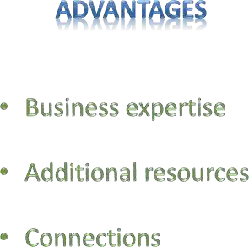
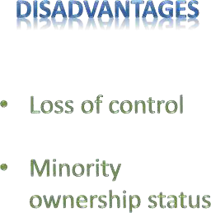

Slide 13



Application of Venture Capital (With a Real-Life Example)
Alibaba and Saif Partners invested
$200 million in Paytm.
Alibaba has a goal of deriving 20- 30% revenue from India with this investment.
In September 2008, Policy Bazaar received venture capital investment of 20 crores from Infoedge.
It again receives investment of 67 crores from Intel Capital and Inventus Capital.

Slide 14

Difference
Sr. No.
Private Equity
Venture Capital
1.
Target Companies
Mature companies, often under-performing or under-valued
Startups, early-stage companies, usually pre- revenue
2.
Target Industries
All industries, usually with established marketplace for the product or service
High-growth industries like high-tech, biomedical, alternative energy
3.
Investor Active
Investors may be passive concerning management, unless purpose of acquisition is to improve company performance
Investors provide advice, connections, distribution, monitor cash burn, etc.

Slide 15

Real Estate Investment Trust (REIT)
A Real Estate Investment Trust (REIT) is a company that owns, operates, or finances income-generating real estate. Investors can buy shares of a REIT, similar to buying stock, and earn a portion of the income produced by the properties, such as rent.
REITs allow individuals to invest in real estate without directly buying or managing property. They are required to distribute most of their income to shareholders, making them a good source of regular income. REITs can invest in various types of properties, like commercial buildings, apartments, shopping malls, or warehouses.

Slide 16

Infrastructure Investment Trusts (InvITs)
Infrastructure Investment Trusts (InvITs) are investment vehicles that allow people to invest in large infrastructure projects such as highways, power plants, or airports. Investors buy units of an InvITs, and the trust manages the projects, collects revenue, and distributes profits to the investors. This makes it easier for individuals and institutions to earn returns from infrastructure without directly owning or managing the projects. InvITs provide a way to generate regular income and diversify investments. They are regulated and provide transparency, making infrastructure investment accessible to more people.

Slide 17
Conclusion
Emerging sources of finance, such as private equity, venture capital, REITs, and InvITs, have transformed the way businesses and investors access funds. These modern financial instruments provide innovative ways to raise capital, support growth, and diversify investment opportunities. They offer advantages like long-term funding, professional management, and the potential for high returns, while also carrying certain risks. By leveraging these emerging sources, companies can meet their financing needs more efficiently, and investors can participate in new sectors and projects that were previously difficult to access. Overall, they play a crucial role in supporting economic growth and expanding investment possibilities in today’s dynamic financial landscape.

